Slide 1
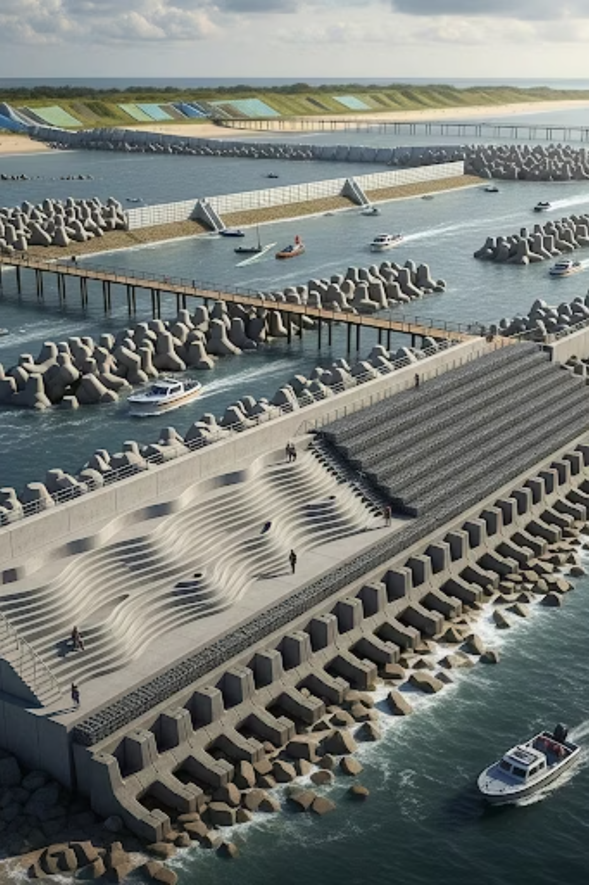
AI-Generated Coastal Protection Strategies: Innovating Against Rising Seas

Slide 2
The Coastal Crisis: Rising Seas and Intensifying Storms
Our coastlines are facing an unprecedented crisis. Rising sea levels and increasingly intense storms threaten communities, economies, and ecosystems worldwide.
By 2300, sea levels could rise from 0.3m to as much as 16m, threatening over 600 million coastal residents globally (Kumar et al., 2023).
Coastal erosion impacts nearly 25% of global beaches; extreme storms have doubled in frequency since the mid-20th century (PNAS Nexus, 2025).
Traditional hard defenses like seawalls are proving costly, inflexible, and unsustainable under current climate change pressures.

Slide 3

Nature-Based AI Innovations: The Sand Engine Paradigm
The Sand Engine in the Netherlands exemplifies how large-scale, nature-based solutions can effectively protect coastlines.
The Sand Motor (South Holland, Netherlands, 2011) involved shaping 21.5 million m³ of sand to harness natural forces for decades-long coastal protection.
AI models simulate sediment redistribution and wave energy dissipation, optimizing design for longevity and cost-efficiency (Kumar et al., 2023).
Result: 95% of the sand was retained after 4 years, significantly reducing maintenance needs and supporting local biodiversity and carbon sequestration.

Slide 4



Architected Artificial Reefs: Wave Energy Dissipation Meets Marine Habitat
Wave Energy Reduction
AI-Optimized Design
Ecological Integration
MIT's modular reef design uses porous cement "voxels" to break >95% of incoming wave energy, reducing wave height from 6m to under 1m (Chu, 2024).
AI-driven hydrodynamic modeling optimizes reef geometry for maximum storm energy absorption and ecological compatibility.
Pilot projects in Massachusetts aim to protect cold-water coasts with scalable, transportable reef walls costing ~$6M per mile, fostering new marine habitats.

Slide 5
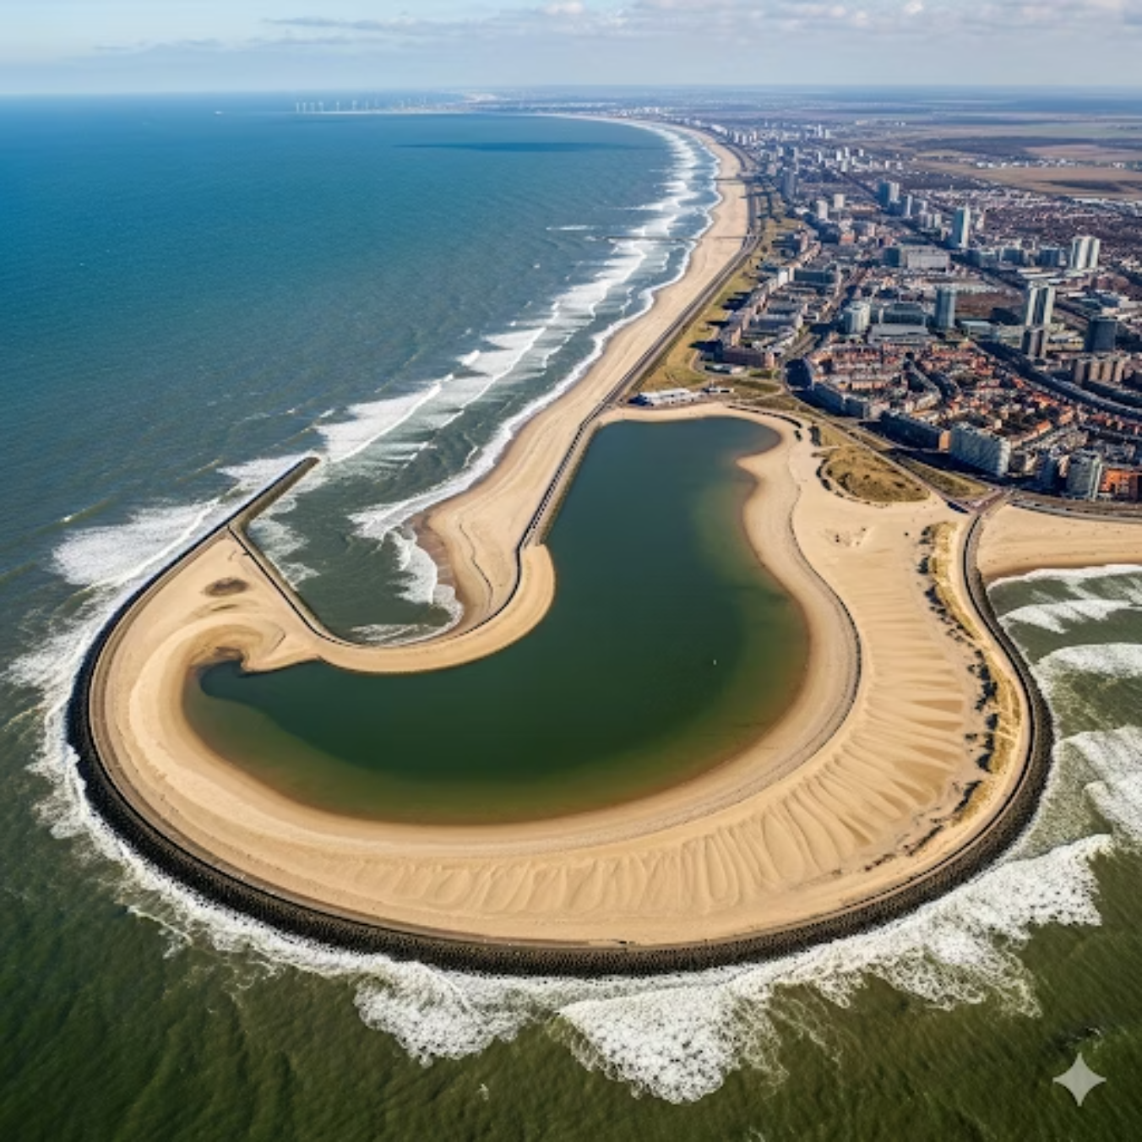
Hybrid Vegetation-Seawall Systems: AI-Optimized Green-Gray Defenses
Combining natural ecosystems with engineered structures offers a synergistic approach to coastal protection, enhanced by AI.
Salt marsh vegetation combined with seawalls significantly reduces wave overtopping and storm surge impacts, enhancing overall resilience (Ayyub, 2025).
AI-based probabilistic frameworks optimize vegetation density, width, and seawall height for the most cost-effective flood mitigation.
Case studies in the Netherlands demonstrate how these hybrid systems lead to lowered levee heights and reduced maintenance costs while boosting vital ecosystem services.

Slide 6

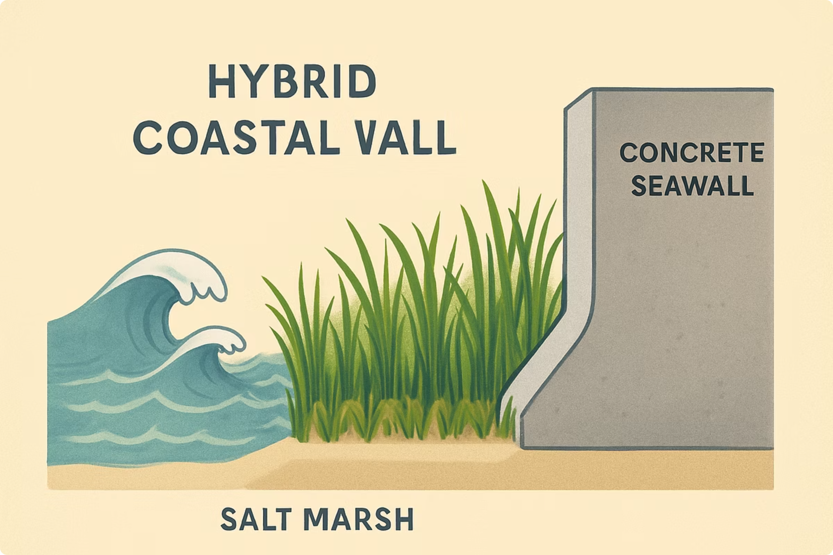
AI-Driven Wave Farm Designs: Harnessing Wave Energy for Coastal Protection
Beyond just energy generation, wave farms can become a dynamic line of defense for vulnerable coastlines.
Artificial Neural Networks (ANN) model Wave Energy Converter (WEC) farms to effectively reduce beach erosion, as demonstrated at Playa Granada, Spain (Rodriguez-Delgado et al.).
ANN optimizes the wave farm layout and positioning, maximizing dry beach area preservation even under severe erosion conditions.
Hybrid wave farms offer a flexible, renewable-energy-integrated coastal defense approach, turning a threat into a resource.

Slide 7
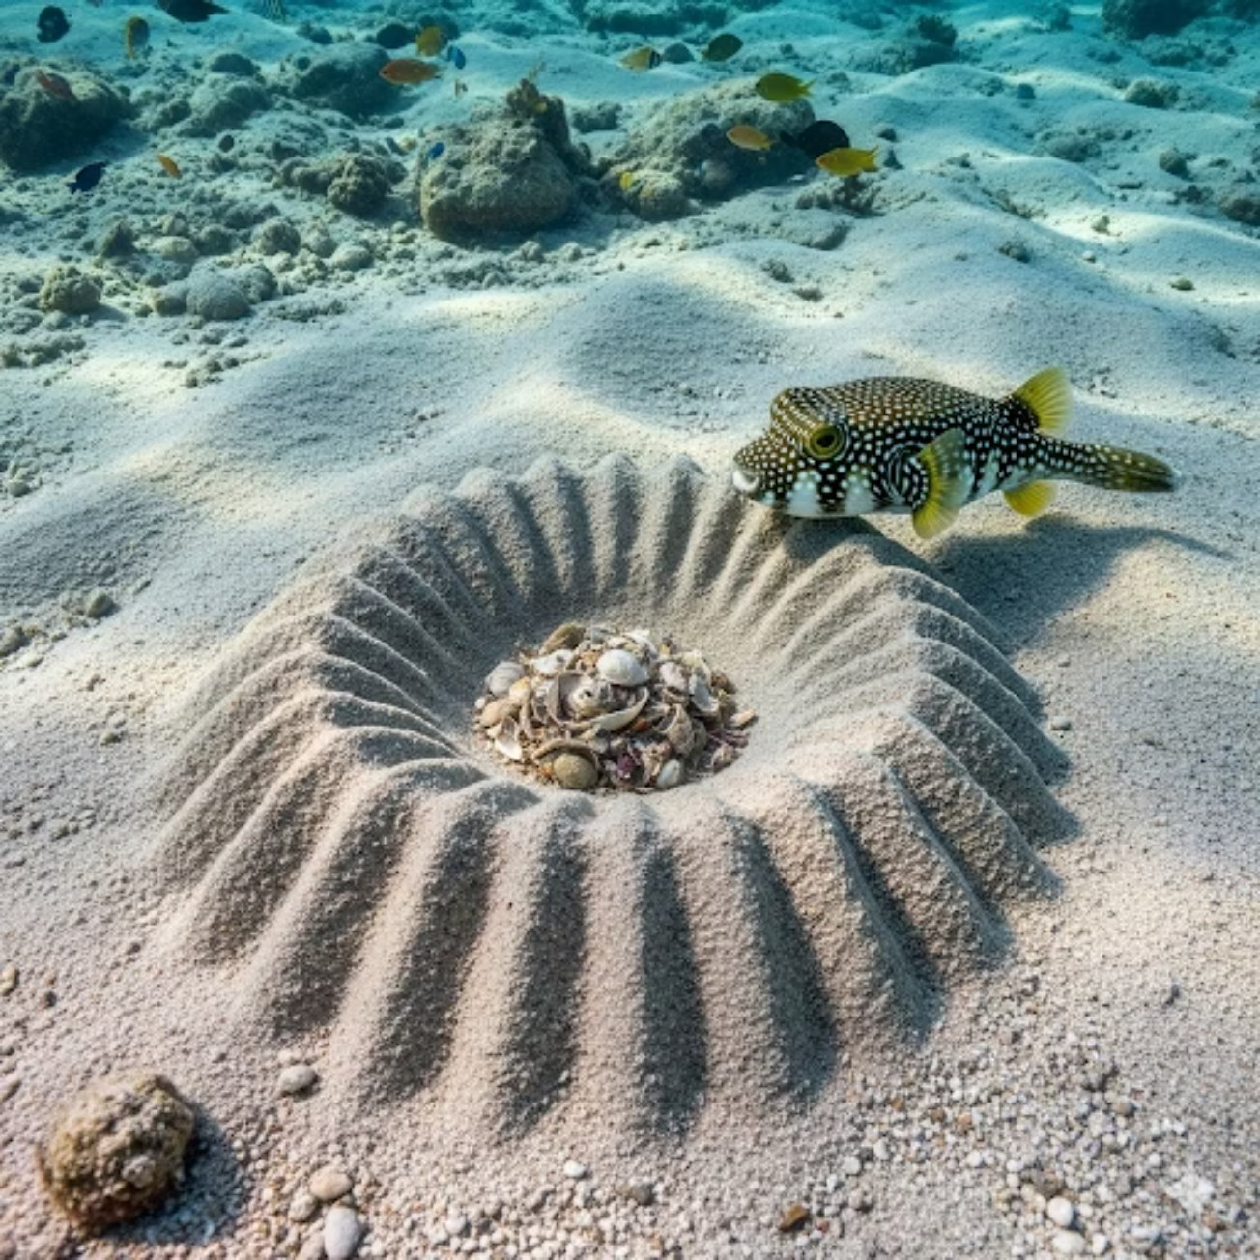
Bio-Inspired Wave Breakers: Nature’s Design Meets Computational Fluid Dynamics
"By mimicking nature's ingenious designs, we can create solutions that are both effective and environmentally harmonious."
Inspired by structures like the unique nest of the Torquigener albomaculosus pufferfish, biomimetic wave breakers are being developed to reduce swell erosion without causing downstream damage (AnthonyE.J., 2023).
Computational Fluid Dynamics (CFD) simulations guide the design parameters to minimize erosion while protecting large coastal stretches, offering soft, reversible solutions that complement AI-optimized hard and hybrid defenses.

Slide 8




Challenges and Lessons from Global Coastal Protection Efforts
Static Defenses
Complex Balance
Traditional hard defenses struggle to adapt to dynamic climate scenarios, requiring constant and costly modifications.
Balancing effective protection with environmental and socioeconomic impacts remains a complex challenge (Williams et al., 2025).
AI's Role
Stakeholder Engagement
AI enables integrated, adaptive management by simulating multiple scenarios and optimizing multi-objective trade-offs for superior outcomes.
Collaborative stakeholder engagement is critical for developing sustainable, scalable coastal resilience solutions that benefit everyone.

Slide 9
Future Outlook: AI as a Catalyst for Coastal Resilience
AI is not just a tool; it's a transformative force that will reshape our approach to coastal protection.
AI integration accelerates the design, testing, and deployment of innovative coastal defenses, significantly reducing costs and environmental footprints.
Emerging technologies enable the creation of modular, scalable, and multifunctional structures that simultaneously protect communities and ecosystems.
Our vision is for AI-powered coastal protection to become a cornerstone of global climate adaptation strategies, safeguarding vulnerable regions worldwide.

Slide 10
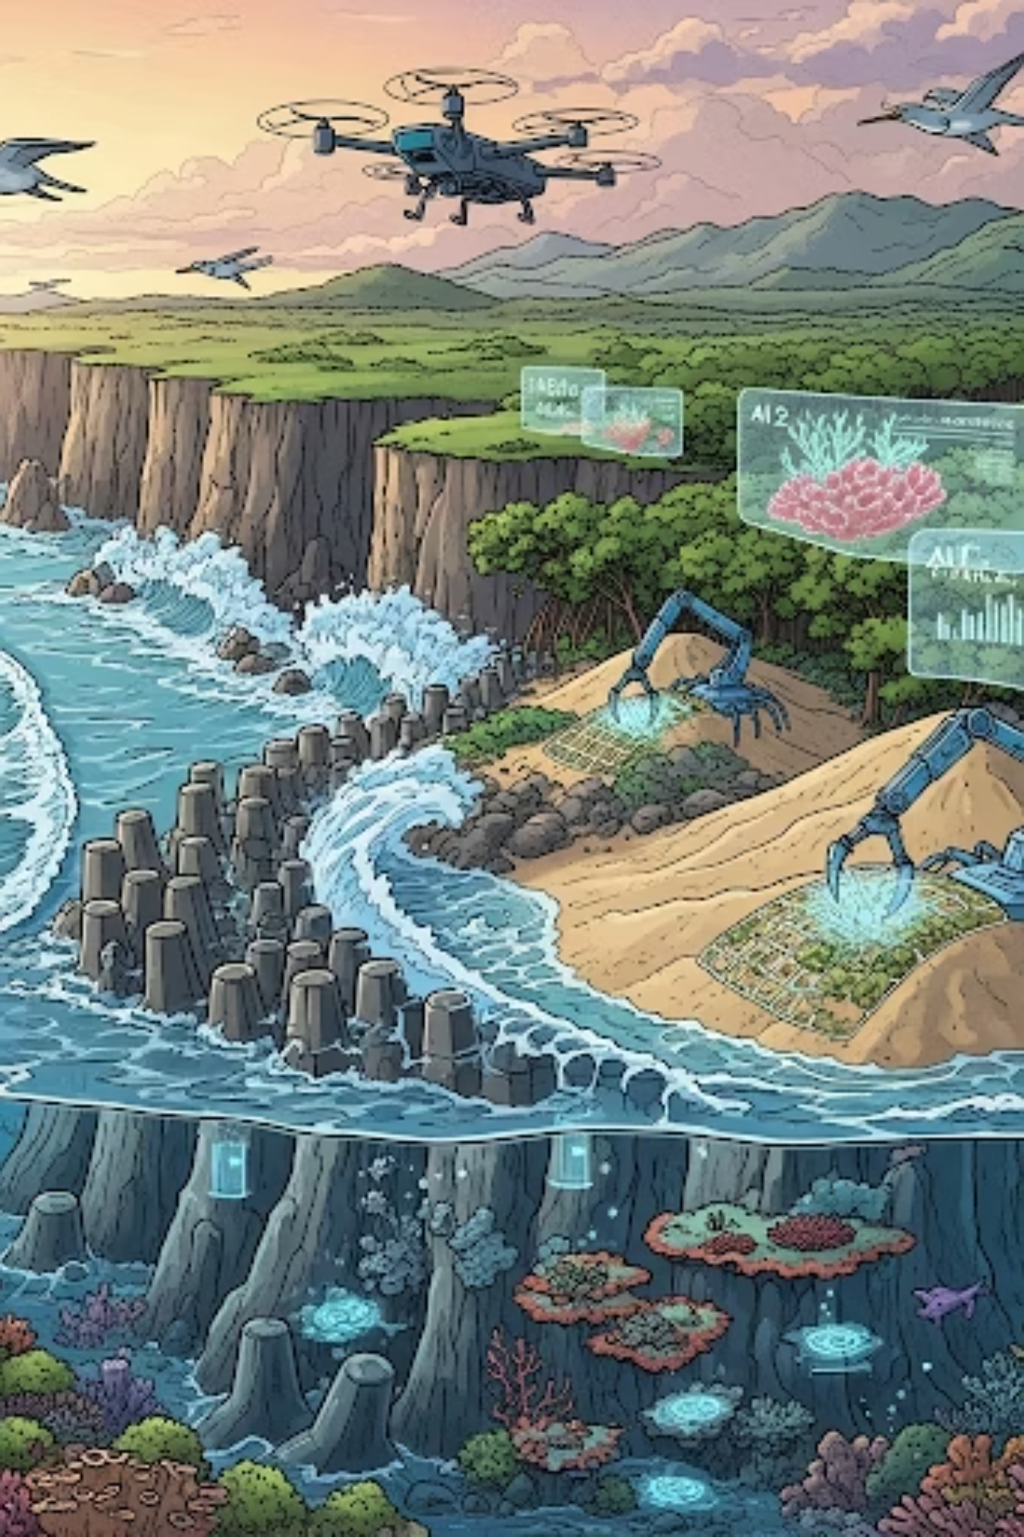
Conclusion: Harnessing AI and Nature to Secure Our Coasts
The fusion of AI with nature-based and engineered solutions offers a transformative path to safeguard vulnerable coastlines from the escalating threats of climate change.
Investing in AI-driven coastal protection today can prevent billions in future storm damage, preserve livelihoods, and protect invaluable ecosystems.
Together, technology and nature can turn the tide against climate threats. The time to act is now.

